Slide 1
Storm Data
Dataset Discovery Day
Stuart Hinson
Meteorologist
National Climatic Data Center – Asheville, NC
Climate Services Division

Slide 2
National Climatic Data Center
Mission:
NCDC’s mission is to manage the Nation's resource of global climatological in-situ and remotely sensed data and information to promote global environmental stewardship; to describe, monitor and assess the climate; and to support efforts to predict changes in the Earth's environment. This effort requires the acquisition, quality control, processing, summarization, dissemination, and preservation of a vast array of climatological data generated by the national and international meteorological services.

Slide 3
History of Severe Weather Data
Severe weather data has been gathered since 1826 when observations were recorded in several texts. Some of these sources are listed below:
Meteorological Register 1826 – 1860
Results of Meteorological Observations 1843 – 1859
Report to the Chief Signal Officer 1870 – 1891
Monthly Weather Review 1872 – 1892
Reports to the Chief of the Weather Bureau 1893 – 1935
US Meteorological Yearbook 1935 – 1945
Climatological Daily National Summary 1950 – 1980
Storm Data 1959 – Current
F8 Typed/Printed format 1959 – 1992
WordPerfect V5.0 format 1993 – 1995
Paradox V7.0 format 1996 – 09/2006
Windows SQL Server 2003 10/2006 – Current

Slide 4
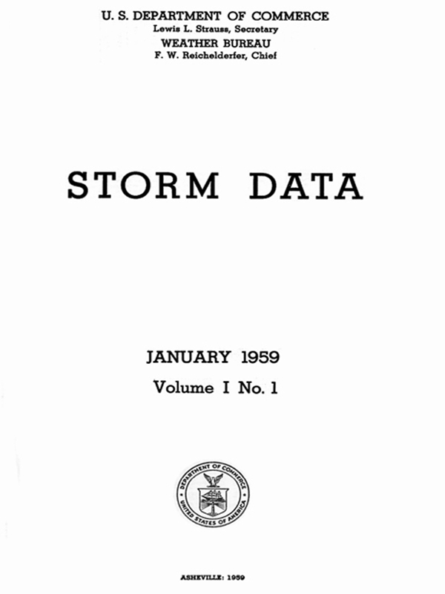
The Storm Data Publication
Storm Data began with the January 1959 issue …

Slide 5
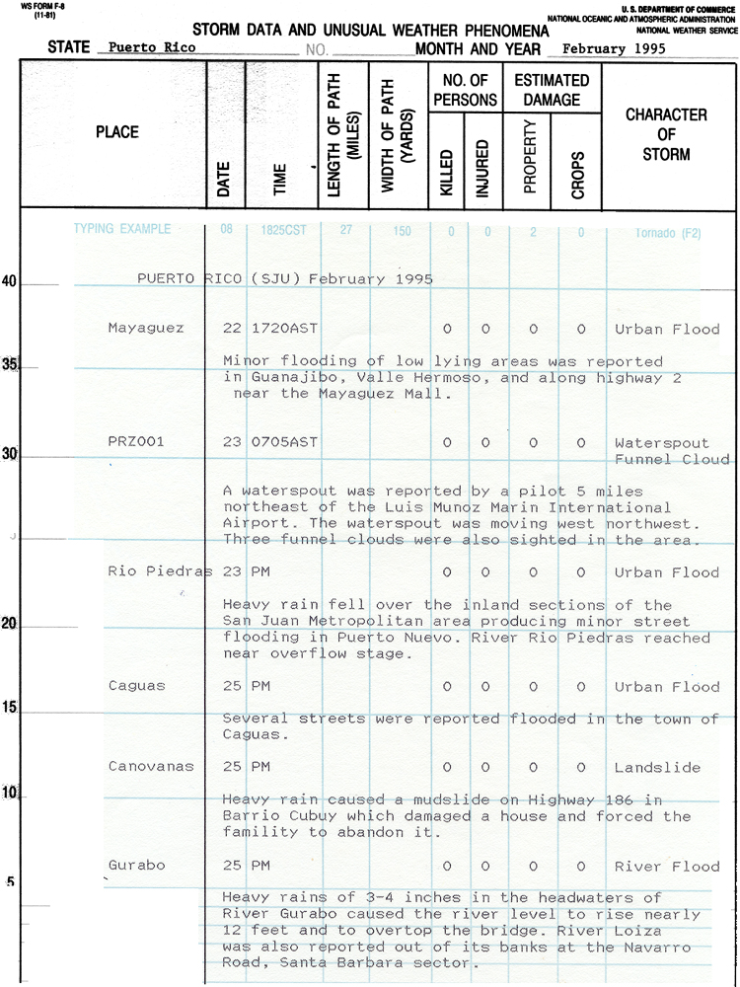
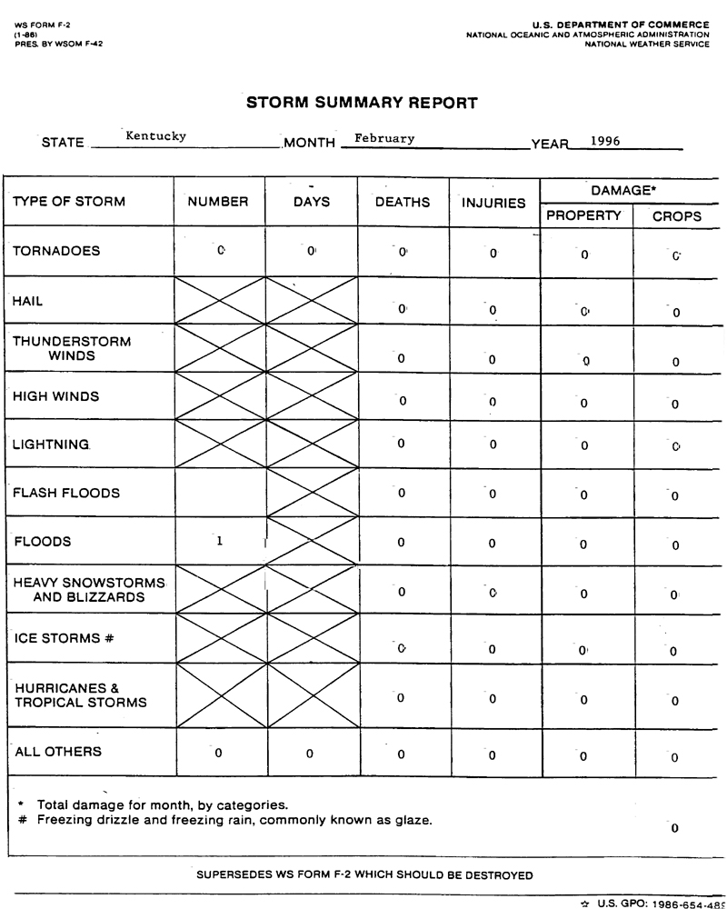
NWS Form F8
NWS Form F2

Slide 6
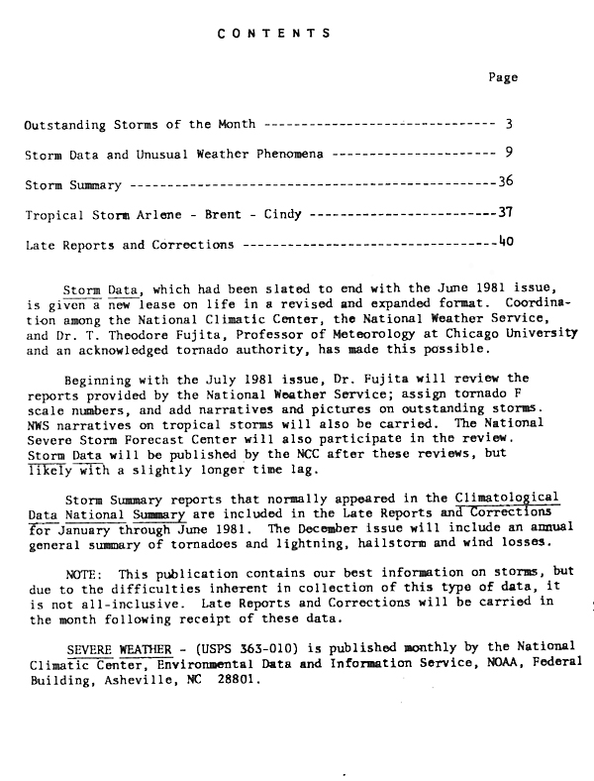
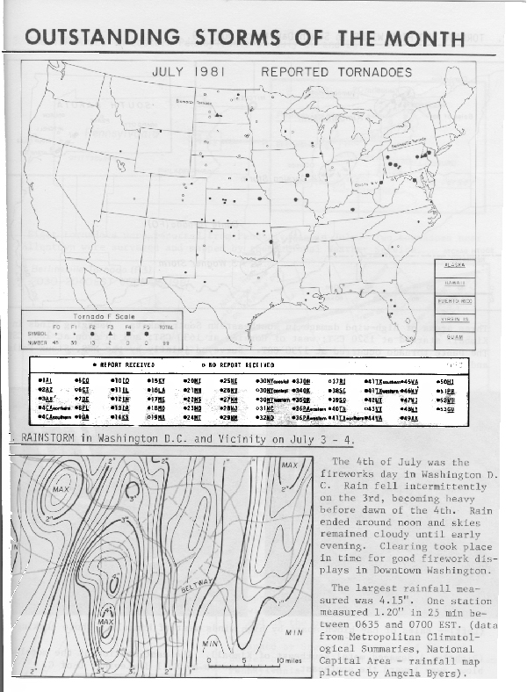
Outstanding Storms of the Month - July 1981

Slide 7
The 1st Generation Storm Events Database
Began as a project to be able to compare radar images with aftermath
Once online, became one of the most popular websites at NCDC
Written in cgi scripts using Visual FoxPro 3.0 in 1996-97
Started with Storm Data in Paradox format, exported to FoxPro.
Added the 1993-1995 data from the WordPerfect disks received at NCDC
Limited Narratives, No lat/lon data provided
Added the Tornado Archive DSI-9617 (1950-1992)
Added SPC Thunderstorm Wind and Hail data (1955-1992)
Added NWS Storm Data in Windows SQL Server 2003
Also use the database to produce the Storm Data Archive DSI-3910, the Lightning Archive DSI-9417 and the Tornado Archive DSI-9617
The National Weather Service Performance Branch developed a new, web-based version of Storm Data using Windows SQL Server 2003

Slide 8
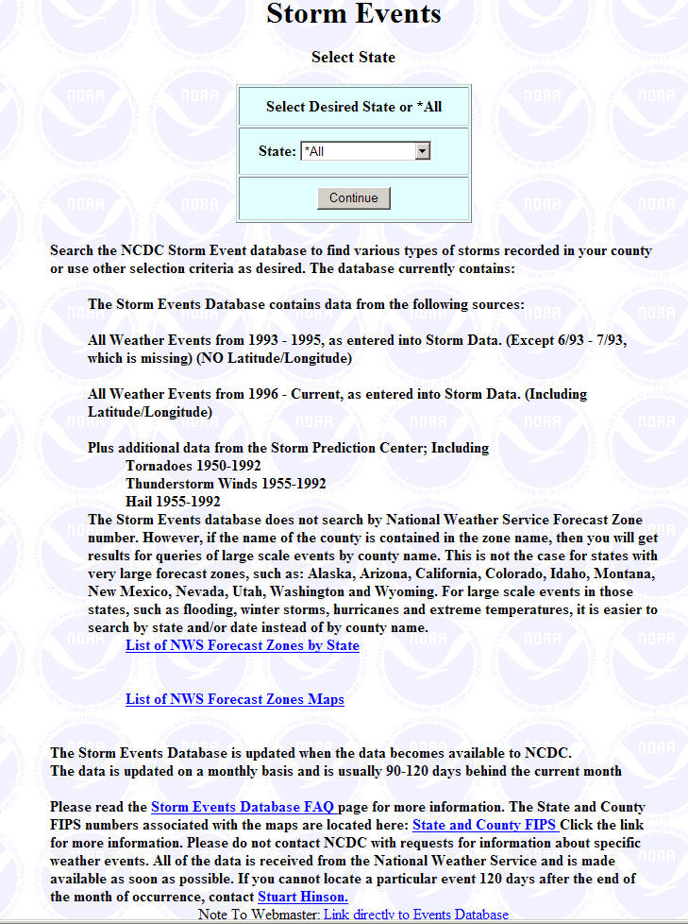
Original Web Access
Very heavily used
A few limitations
Limited functionality
Latitude/Longitude
Limited search
Missing data
County based events vs. Zone based events
Forecast zone changes
Damage amounts
Event types not standard

Slide 9
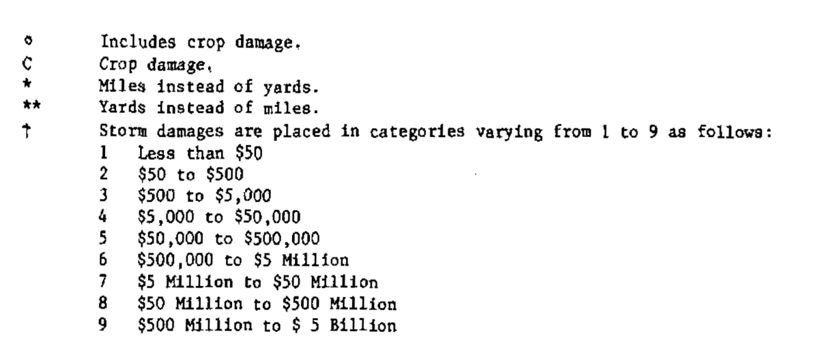
The 1st Generation Storm Events Database
Property and Crop Damages
NWS Form F8 used “Damage Categories” (1959-1995)
When imported, had to replace category with data value
Used pseudo-median (divide upper limit by 2)
Cat 6 would be 2.5M (no data are adjusted for inflation)
Image from Storm Data publication

Slide 10
Data Sources
Amateur Radio | Buoy | State Official | Broadcast Media
Other Federal Agency | Storm Chaser | Trained Spotter | Official NWS Observations
Post Office | ASOS | Cocorahs | Coop Observer
Mariner | Newspaper | Park/Forest Service | Social Media
Insurance Company | Law Enforcement | River/Stream Gage | Airplane Pilot
Emergency Manager | NWS Employee | Coop Station | Mariner
Law Enforcement | Amateur Radio | Official NWS Obs. | Trained Spotter
General Public | Unknown | Dept Of Highways | Coastal Observing Station
Utility Company | Shave Project | Newspaper | Broadcast Media
Post Office | Snotel | Govt Official | Meteorologist (Non-NWS)
NWS Storm Survey | AWOS,ASOS | Drought Monitor | 911 Call Center
Mesonet | Fire Dept/Rescue Squad | RAWS | NWS Employee (Off Duty)
Other Federal Agency | Public | County Official | Airplane Pilot
Park/Forest Service | C-Man Station | Coast Guard | Fire Department/Rescue
Unknown | Buoy | Department of Highways | NWS Storm Survey
Utility Company | Emergency Manager | Insurance Company | Other Federal

Slide 11
Storm Data Disclosure
Storm Data is an official publication of the National Oceanic and Atmospheric Administration (NOAA) which documents the occurrence of storms and other significant weather phenomena having sufficient intensity to cause loss of life, injuries, significant property damage, and/or disruption to commerce. In addition, it is a partial record of other significant meteorological events, such as record maximum or minimum temperatures or precipitation that occurs in connection with another event. Some of the information appearing in Storm Data may have been provided by or gathered from sources outside the National Weather Service (NWS), such as the media, law enforcement and/or other government agencies, private companies, individuals, etc. An effort is made to use the best available information, but because of time and resource constraints, information from these sources may be unverified by the NWS. Therefore, when using information from Storm Data, customers should be cautious as the NWS does not guarantee the accuracy or validity of the information. Further, when it is apparent information appearing in Storm Data originated from a source outside the National Weather Service (frequently credit is provided), Storm Data customers requiring additional information should contact that source directly. In most cases, NWS employees will not have the knowledge to respond to such requests. In cases of legal proceedings, under Department of Commerce regulations and/or rules of the court, NWS employees are not legally obligated to provide written or verbal testimony

Slide 12
The Enhanced Storm Events Database
NCDC uses Oracle database platform
All data from old system had to be reformatted
Dates fields were in text format, etc…
Times were 2359, 23:59, 11:59 PM etc
All event types had to be “normalized” into standards (48)
Data from 1996-1999 had “free text” field for Event Types
Over 950 unique values had to be correctly categorized
Multiple Event Types per record had to be “split” into two
Thunderstorm Wind/Hail, Hail/Tornado, etc

Slide 13
The Enhanced Storm Events Database
Expected Results
Higher quality data by fixing erroneous/questionable data
Possible Integration using radar, satellite, lightning products
Multi-point tornado tracks, polygons for flash floods
Future Enhancements by the NCDC
Added query functionality
Search by hail size, wind speed, number of injuries/fatalities, amount of property/crop damage
Enhanced query output options (csv text and PDF - F8 format)
Adding damage/evidence photographs to web application and output

Slide 14
The Enhanced Storm Events Database
Caveats
Data are entered by 124 unique WFOS (Weather Forecast Offices)
Damage amounts are “Best Guess Estimates” as received from the NWS (plus the damage category issue with pre-1993 data)
Number of events has dramatically increased due to advances in technology and population density in previously sparse areas
Hurricane Katrina (August 2005)
It took more than a year to collect the fatality statistics
It also occurred during a transition from Paradox to Windows SQL Server 2003 (October 2006)
Will manually update fatalities/injuries and Property/Crop damage amounts

Slide 15
The Enhanced Storm Events Database
Progress and Timeline
Started with the latest data and working backwards
Oct 2006 – Currently loaded into new web application
Jan 2000 – Sep 2006 are currently being tested and loaded
Jan 1996 – Dec 1999 are currently “under repair”
Event Type had a free-text field allowing user to input non-standard event types
Systematically able to repair most of the event types by writing code to match/replace non-standard event types
Manually adjust those that are unable to be programmatically replaced.
Jan 1993 – Dec 1995
Reducing from “ALL” event types to Thunderstorm Winds, Tornadoes and Hail.
Splitting multiple event types into individual events
Mostly “TSTM WIND/HAIL”
1950 – 1992
Will import the Thunderstorm Wind and Hail databases from the SPC (Storm Prediction Center)
Will import the Tornado Archive DSI-9714 from the NCDC Archive
Csv text files will be easily imported (damage categories, no values)

Slide 16
Notes/Links
NWS Directive 10-1605
http://www.nws.noaa.gov/directives/sym/pd01016005curr.pdf
Storm Events Database
http://sansari.dev.ncdc.noaa.gov/stormevents-dev/
Development Server
Tuscaloosa Tornado
Storm Data Publication
http://www7.ncdc.noaa.gov/IPS/sd/sd.html
Related Research
SWDI (Severe Weather Database Inventory)
http://www.ncdc.noaa.gov/swdi/#Intro
WDSSII (The Warning Decision Support System – Integrated Information)
http://www.wdssii.org/
SHAVE (Severe Hazards Analysis & Verification Experiment
http://ewp.nssl.noaa.gov/projects/shave/index.php
HVRI SHELDUS (Hazards Vulnerability Research Institute - Spatial Hazard Events and Losses Database for the United States
http://webra.cas.sc.edu/hvri/products/sheldus.aspx

Slide 17
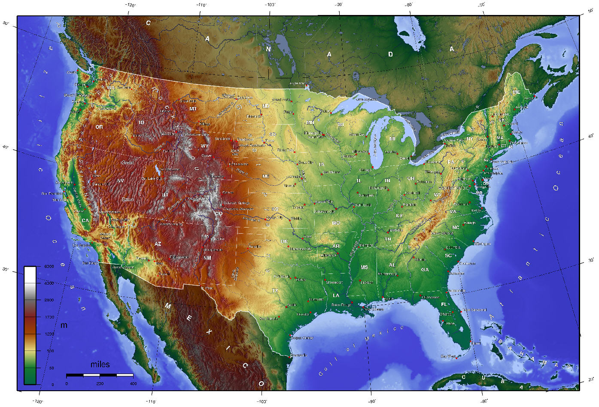



U.S. Storm Events Database
Location
Begin Date
US
AK
End Date
HI
PR
VI
PAC
County Based Event Types
Zone Based Event Types
Tornado
to
Hurricanes and Tropical Storms
Temperature Extremes
Floods
Tstm Winds
to
Hail
to
Winter Weather Snow & Ice
Drought
Precipitation
to
Flash Floods
Wild Fires & Forest Fires
High Winds (non-convective)
Fog

Slide 18
The Future of Storm Events Database
Can we improved data entry consistency?
Starts at the point of entry – the NWSFO…
Can we improve the timeliness?
Possible ingest from NWS in near real-time
Direct input from NWS LSR (Local Storm Reports)
Can we improve data dissemination?
GIS-based
Web Map services
Multiple data export formats

Slide 19
Conclusion
An increase in new technology will allow for a much more robust, user-friendly system
Understand the importance of the need for recording high quality data.
Consistency is the key
In-depth training
Damage estimation
Multiple Product Generation requires consistency
Storm Data Publication
Storm Events Database
Storm Data Archive (DSIs 3910/9714/9617)
Storm Data Users - Database export
Property damage amounts should be used if at all possible

Slide 20
Thanks!
Questions?
Contact: Stuart Hinson – Storm Data
http://www.ncdc.noaa.gov/stormevents/
Stuart.Hinson@noaa.gov
828-271-4800 x3169

